Slide 1
Eventify - GitHub Organization
Event management and ticketing platform
Team 1

Slide 2
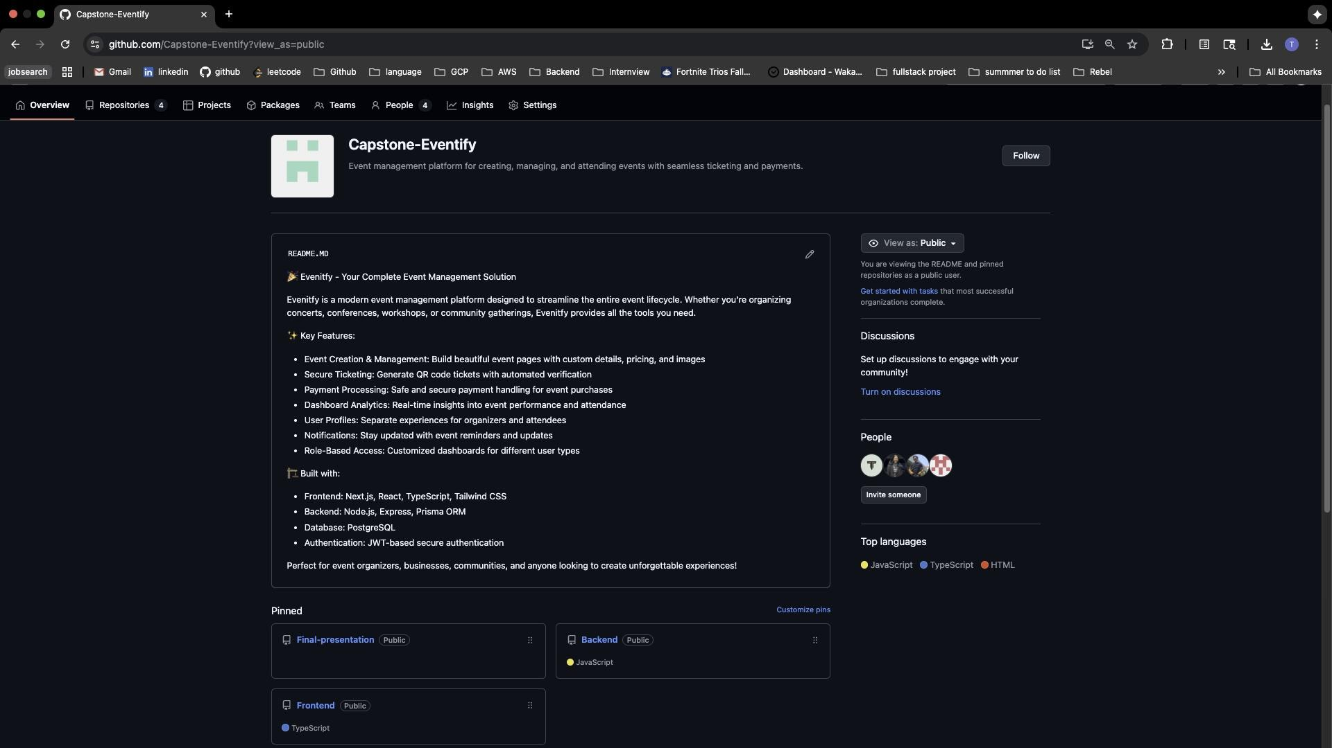
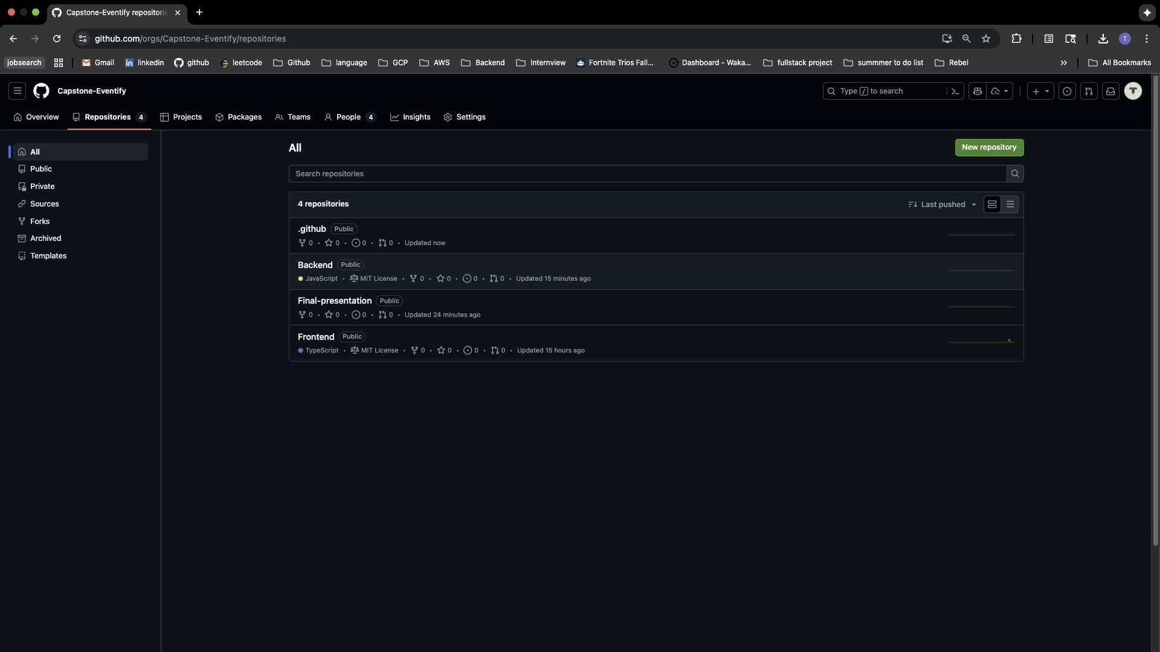
Organization-Overview
Repositories:
  Frontend (TypeScript, MIT License)
  Backend (JavaScript, MIT License)
  Final-presentation (Public)
Status: Active development
Visibility: Public

Slide 3
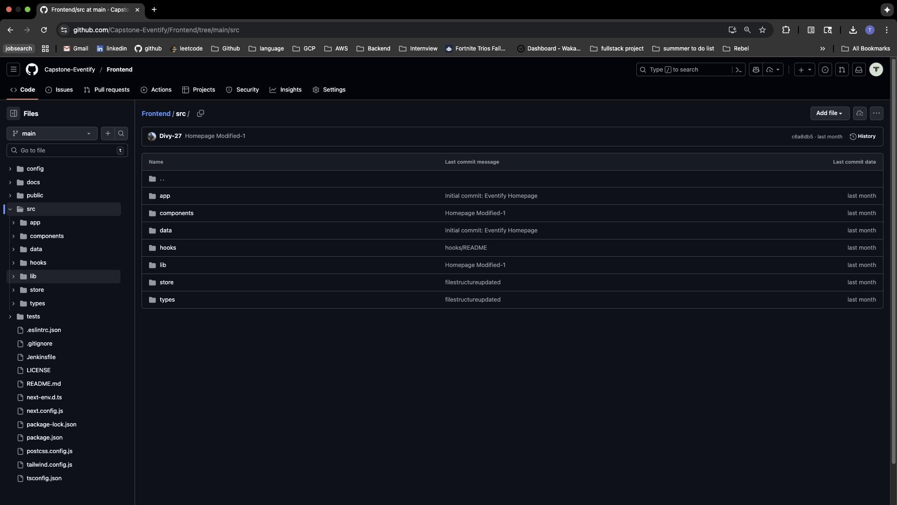
Frontend
Technologies:
Framework: Next.js 14 with App Router
Language: TypeScript
Styling: Tailwind CSS
Features: Homepage with Hero, Features, Pricing sections
Commits: "Initial commit: Eventify Homepage"
Key Folders:
src/app/ - Page routes
src/components/ - Reusable UI components
src/data/ - Mock data

Slide 4
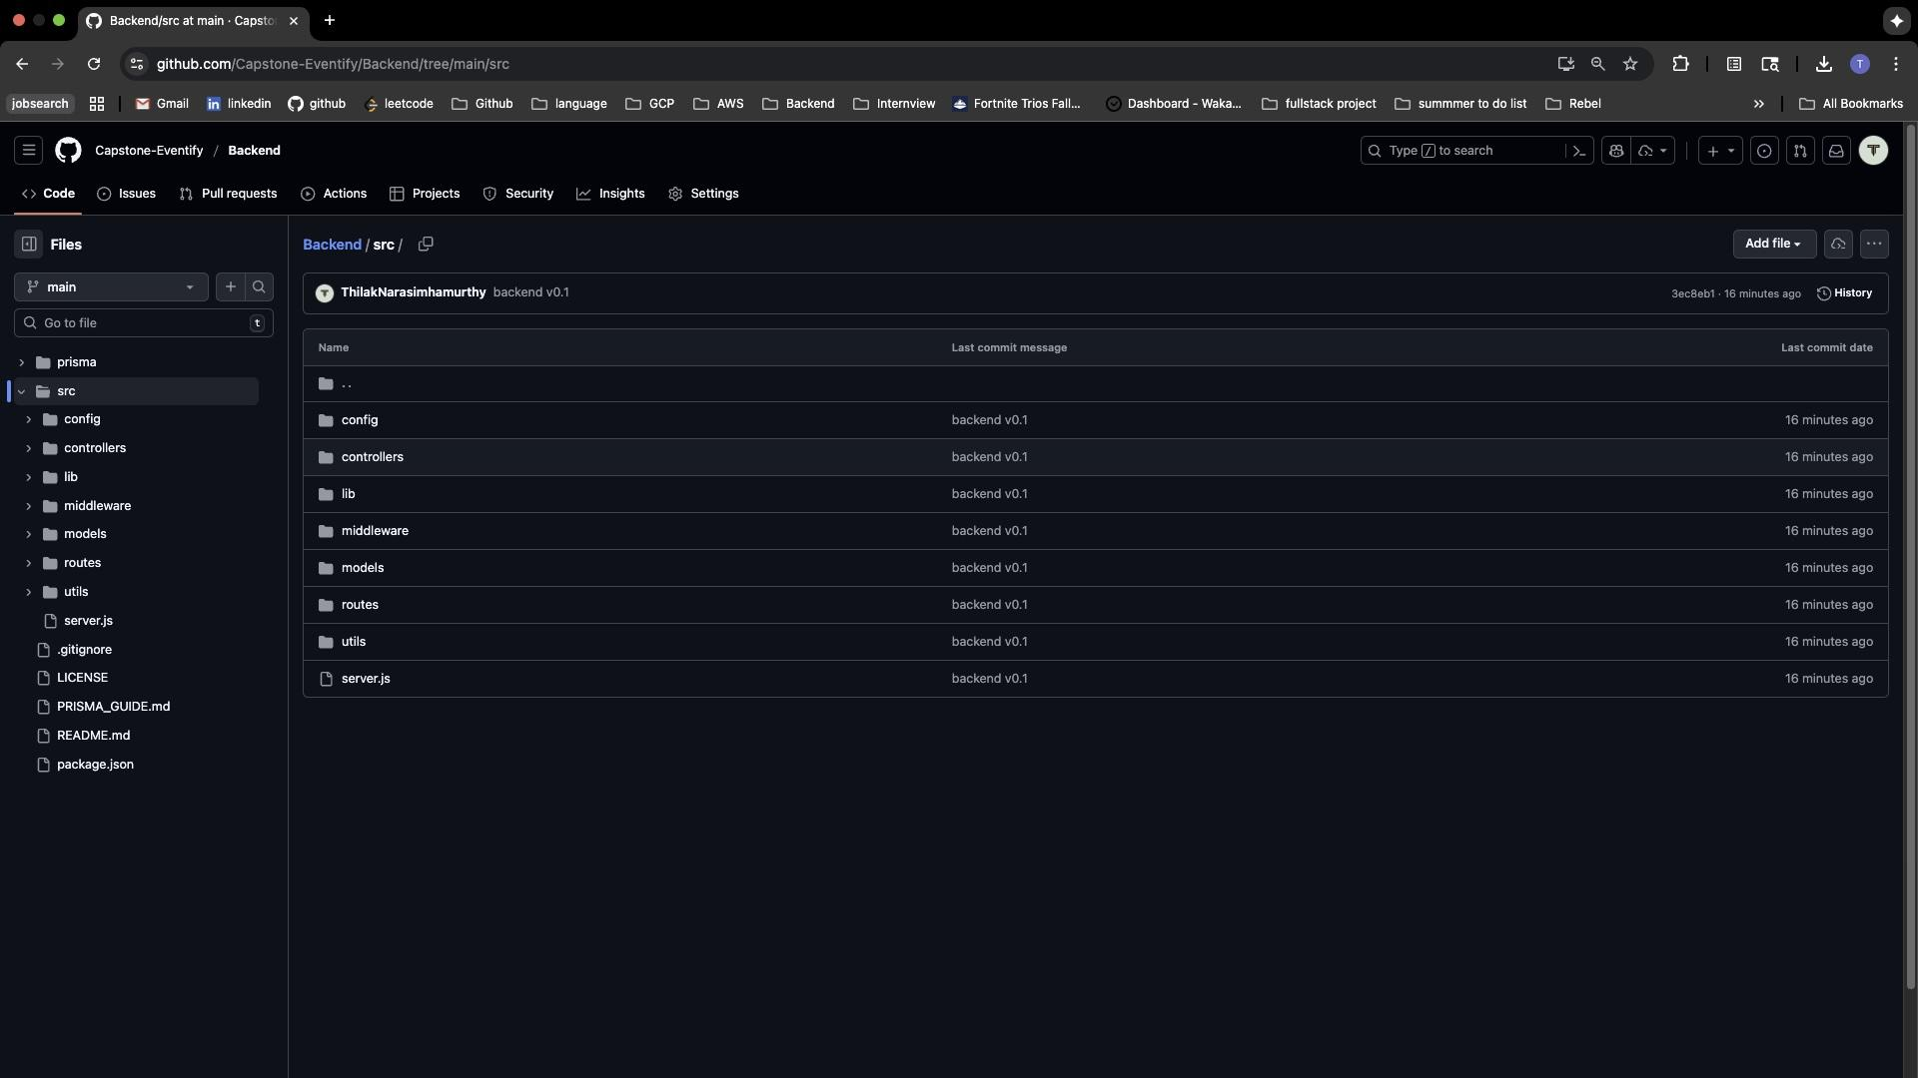
Backend
Technologies:
Runtime: Node.js
Framework: Express.js
Database: PostgreSQL with Prisma ORM
Features: Authentication, Event Management, Payment Processing
Commits: "backend v0.1"
Key Folders:
src/config/ - Database configuration
src/controllers/ - Request handlers
src/routes/ - API endpoints
src/middleware/ - JWT authentication

Slide 5
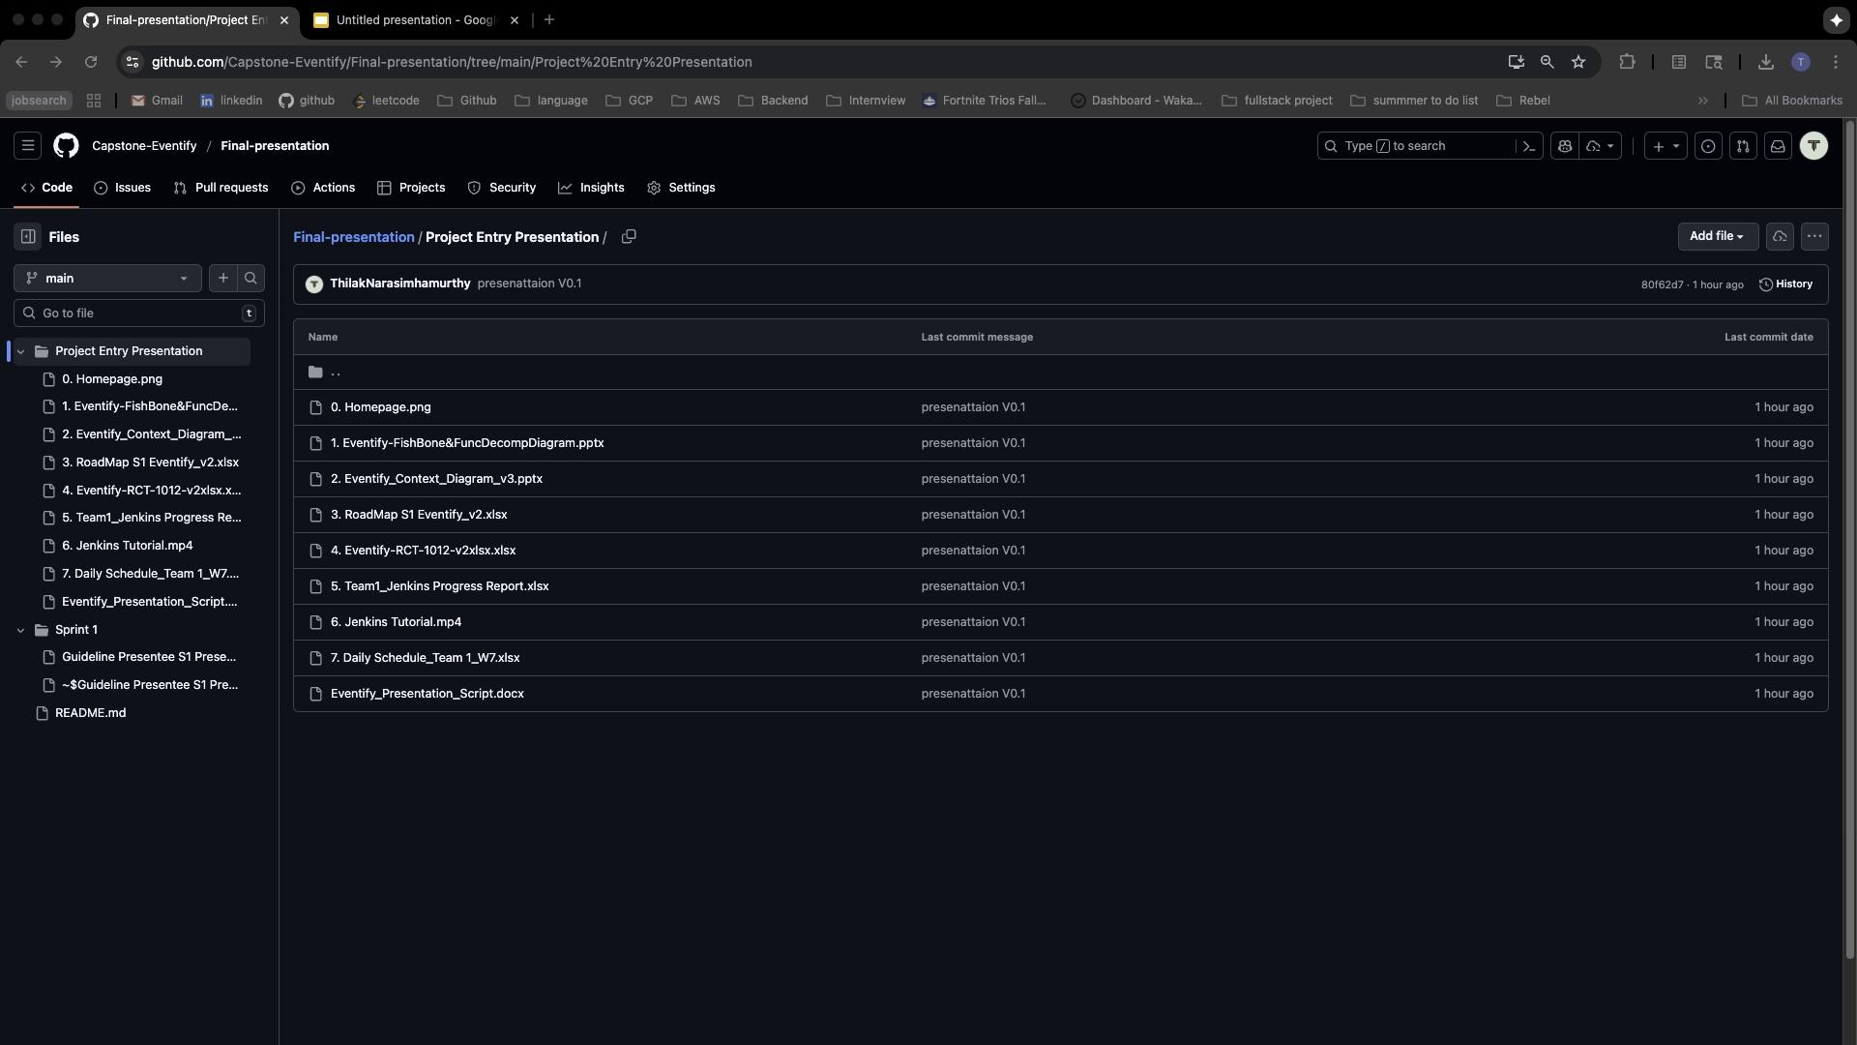
Final
Presentation
Tracked deliverables from entry through final submission
Sprint documentation
Project Entry materials:
  Fishbone and Context diagrams
  Roadmap
  Jenkins progress reports
  Presentation scripts

